Slide 1
Analysis on Movie data
By Noah Jackson and Sydney Spacek

Slide 2
Motivation
For our project we wanted to use the methods we learned in class to better understand the world around us – and what better place to start then the entertainment industry. With this goal in mind we asked ourselves:
Do different genres of movies effect movie run time?

Slide 3
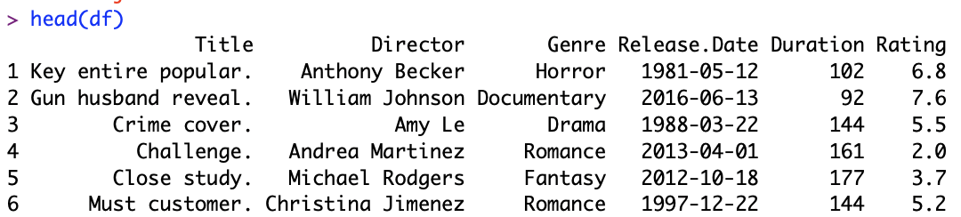
Data Description
The dataset our group decided to use as the focus of this project is the Movies Dataset (1980-2020):
This dataset comes from the Kaggle website (which offers a multitude of different types of datasets),
Provides information on the titles, directors, genres, release dates, durations and ratings of different movies from 1980 to 2020.
Because of the size of our dataset (30,000+ movies) and because it is constructed from information spanning multiple decades, we feel relatively confident in this dataset's lack of bias so that we can assume a random, independent sample is taken from the population.

Slide 4
Goal of Study
We will use certain methods we learned in class to explore possible connections and/or differences between different movie genres and their runtime. We will then go into seeing if the decade the movie was released makes a difference on runtime. We believe that this analysis could provide interesting conclusions about the entertainment industry.

Slide 5
Methods
The methods we utilized to analyze our data set include Welch’s two sample t-test and a one-way ANOVA test (5% significance level). We decided to use these methods because they best fitted our goals in analyzing differences in movie runtime from genre to genre. Doing this gave us the results in the following slides.

Slide 6
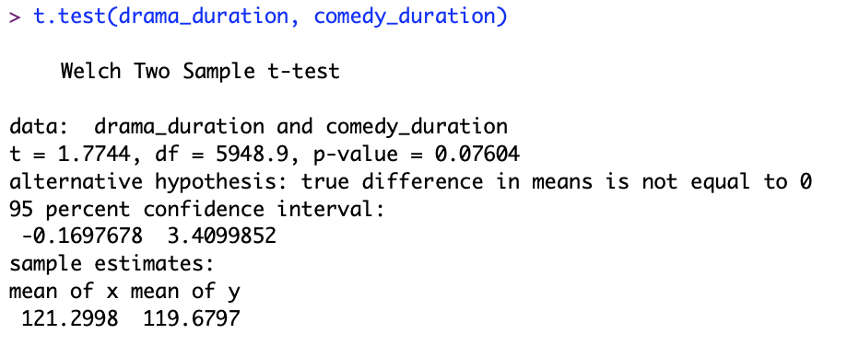
Results – Welch’s Two Sample T-test
Null Hypothesis is that there is no difference in the mean duration in runtime between Dramas and Comedies
Our d.o.f. for this test was close to 6000
We found a t-value of 1.7744 and a p-value of 0.07604.
Since p-value = 0.07604 > 0.05 = sig level, we fail to reject the null (but did come close to rejecting)

Slide 7
Results – One-Way ANOVA
Drama and Comedy movies are only 2 genres and a Welch’s t-test can’t analyze anything about runtime and genres in general. With this in mind, we look to a one-way ANOVA test.

Slide 8
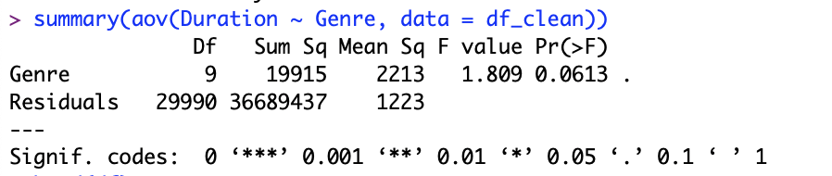
Results – One-Way ANOVA
Null Hypothesis – genre has no effect on runtime of movies
Our F-statistic we found was 1.809, and our p-value is 0.0613
Since p-value = 0.0613 > 0.05 = sig level, we fail to reject the null.

Slide 9
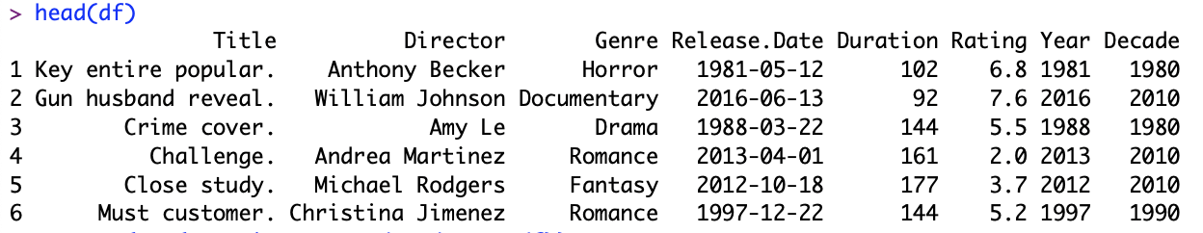
Results – One Way ANOVA for Decades
We wanted to further explore this dataset by investigating if the decade the movie was made in had an effect on runtime
To do this test, we had to add 2 other column for each entry which told us the decade in which the movie was released and the year it was released. The head of the dataframe now has 2 added column:

Slide 10
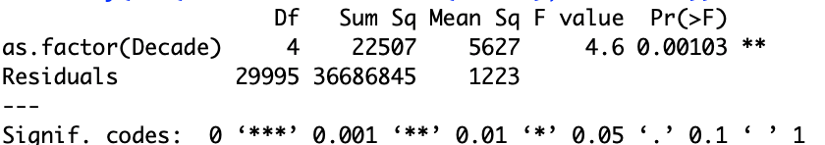
Results – One Way ANOVA for Decades
We now could do a One-Way ANOVA to see if decade made a difference on runtime
Null – Decade doesn’t make a difference on runtime of movies
We found our p-value to be 0.001 and is less than sig level, so we reject the null in favor of decade making a difference on runtime.

Slide 11
Conclusion
Due to our results being over a 0.05 p-value for our first two tests, we cannot conclude (at the 5% significance level) that:
Drama and Comedies have a different mean runtime
Genre has an effect on movie runtime
However, we can conclude that:
The decade does have an effect on how long the runtime of a movie is
These results can help us better understand about the entertainment industry and the world around us, by informing us how we spend our time according to our interests.

Slide 12
Q&A?

